Slide 1
Causal Discovery & Network Science
Praharsh Nanavati Department of Data Science and Engineering Indian Institute of Science Education and Research, Bhopal

Slide 2
What is causal inference?
Inferring the effects of any treatment/policy/intervention/etc.
Examples:
Effect of treatment on a disease
Effect of climate change policy on emissions
Effect of social media on mental health
Why is this tough to achieve?
Reference: Causal Inference by Brady Neal

Slide 3
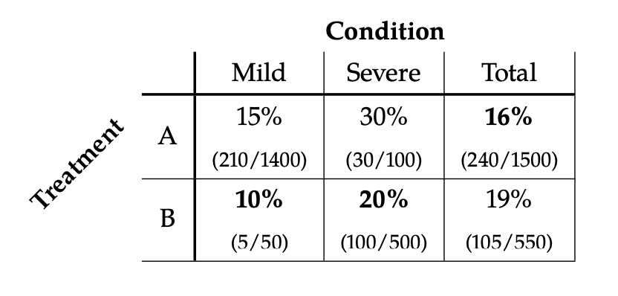
Reference: Causal Inference by Brady Neal

Slide 4
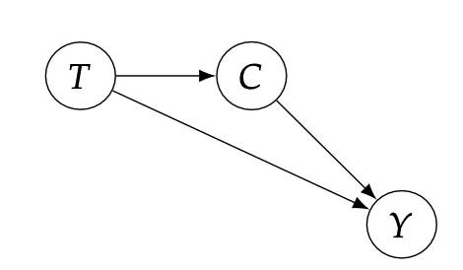
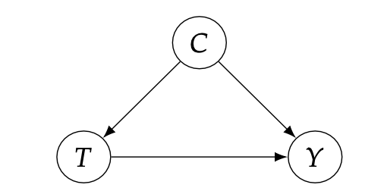
If we consider the causal graph given above and assume the condition 𝐶 to be a cause of the treatment 𝑇,
Then treatment B would be more effective at reducing mortality 𝑌.
However, if you look at the overall mortalities, treatment A seems to be better. This is because ‘C’ confounds the effect of treatment on mortality.
Similarly in this case, if T is a common cause of the condition as well as the outcome,
Treatment A is more effective since the prescription of treatment B would cause more patient’s conditions to worsen.
For eg, if treatment B were scarce, the condition of patients with mild conditions that were prescribed B would worsen.

Slide 5
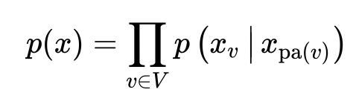
Causal Graphs
Are Directed Acyclic Graphs (DAGs) by assumption. However, recent work also talked about Cyclic Directed Graphs – for eg: Positive Feedback Loops in Climate Studies etc.
These relationships can be best encoded via Bayesian Networks!

Slide 6
Correlation does not imply Causation!
But, What does!?

Slide 7
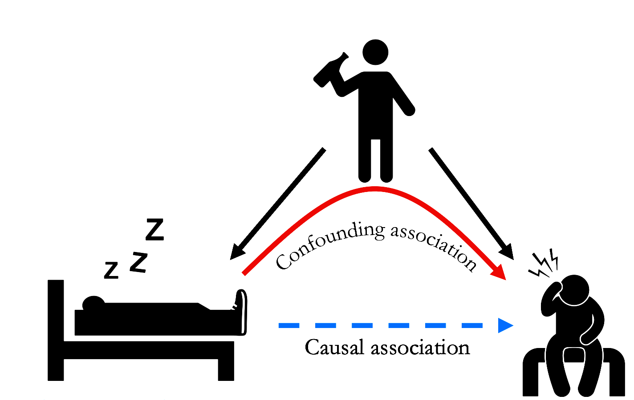
Effect of Confounders
Reference: Causal Inference by Brady Neal

Slide 8
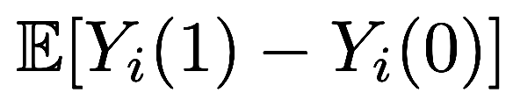
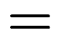
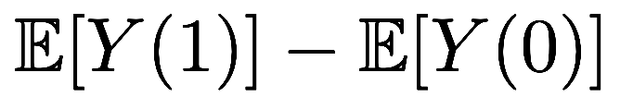

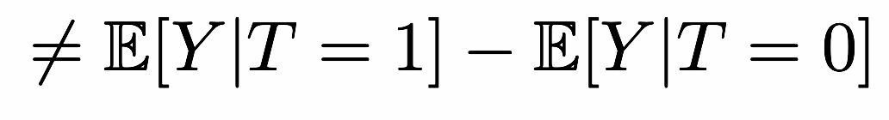
Due to the presence of confounding, calculating the average treatment effect is difficult, because:
This is because not all causal quantities are statistically ‘Identifiable’.

Slide 9

Your attention
Headaches (Hidden Confounding?)

Slide 10
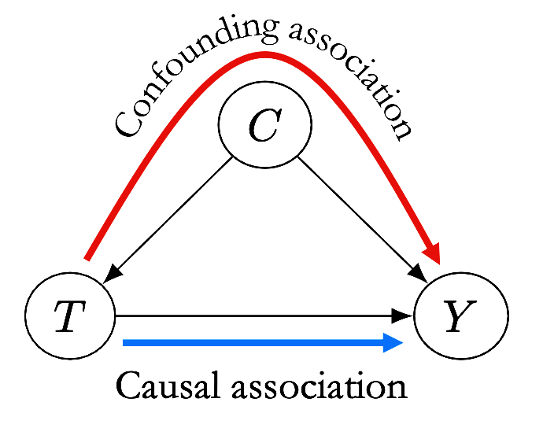
We use statistical tests for conditional independence to test whether there is any kind of relationship between C and T. If no dependence is found, that is, the two are statistically independent, then the Faithfulness condition tells us that there is no causal relationship and we can remove the edge from our graph.
Reference: Causal Inference by Brady Neal

Slide 11
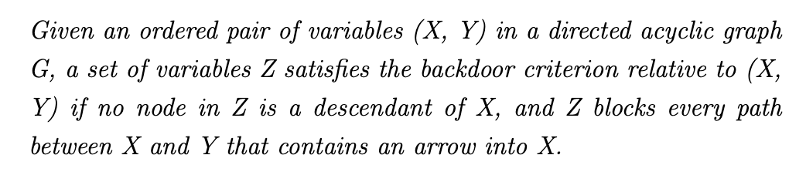
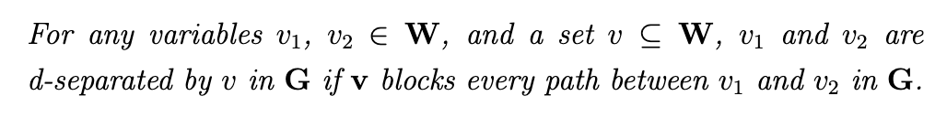
Backdoor Criterion
d-Separation

Slide 12
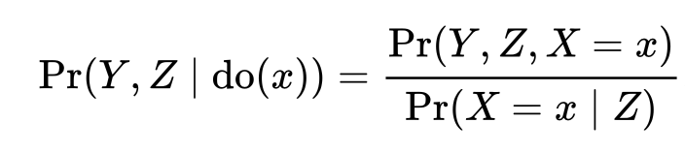

Slide 13
Structural Equation Model (SEM)
Structural Equation Models are models that explain relationships between measured variables and latent variables, and relationships between latent variables.
Latent variables are variables that, as humans, we understand as a concept, but that cannot be measured directly.
The Causal Foundations of Structural Equation Modeling, J. Pearl, 2021.
Structural Equation Modeling, Joos K, Towardsdatascience, 2021.

Slide 14
Structural Causal Model (SCM)
Mathematically, a Structural Causal Model (SCM) consists of a set of Endogenous (V) and a set of Exogenous (U) variables connected by a set of functions (F) that determine the values of the the variables in V based on the values of the variables in U.
Intuitively, if we think of a DAG as representing a flow of information, then the variables U are the inputs to the system, while the variables V are the nodes where that information is processed.

Slide 15
“ The idea of autonomy and invariance is deeply ingrained in the concept of structural equation models (SEMs) or SCMs. We prefer the latter term, since the term SEM has been used in a number of contexts where the structural assignments are used as algebraic equations rather than assignments”.
~ Elements of Causal Inference, Peters et al.

Slide 16
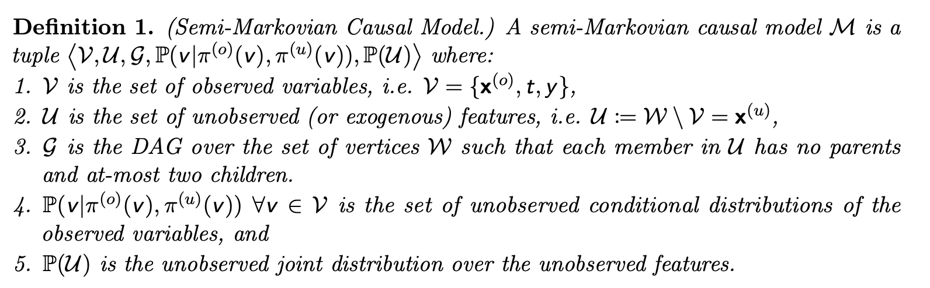
Semi-Markov Models
*In a semi-Markovian model, unobserved variables with only one or no children are omitted.
Finding Valid Adjustments under Non-ignorability with Minimal DAG Knowledge, Shah et al, 2022

Slide 17





Slide 18
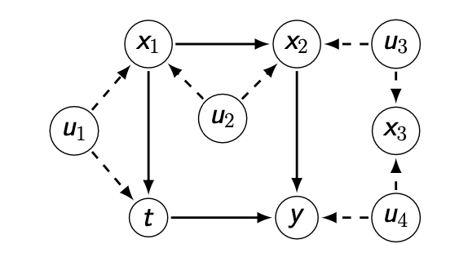
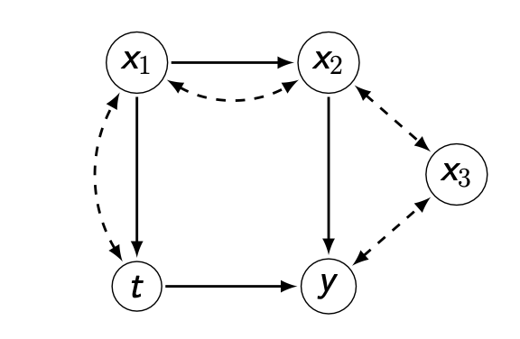
Semi-Markov Models
*In a semi-Markovian model, unobserved variables with only one or no children are omitted.
Finding Valid Adjustments under Non-ignorability with Minimal DAG Knowledge, Shah et al, 2022

Slide 19
This can broadly be classified as the Pearlian Framework of Causal Inference, developed by the renowned Computer Scientist, Judea Pearl.
However, assuming that the causal graph is always fully available is a very strong assumption.
Secondly, this approach is often difficult to follow in case of data-centric processes.

Slide 20
The Pearlian framework commonly assumes structural knowledge (provided by an expert) in the form of directed acyclic graphs and provides graphical criteria such as the back-door criterion to identify the valid adjustment sets.
These valid adjustment sets are a minimal subset, Z of the covariates X. If we condition on this set Z, then the causal effect (T -> Y) can be isolated, and we can directly calculate the treatment effect.

Slide 21
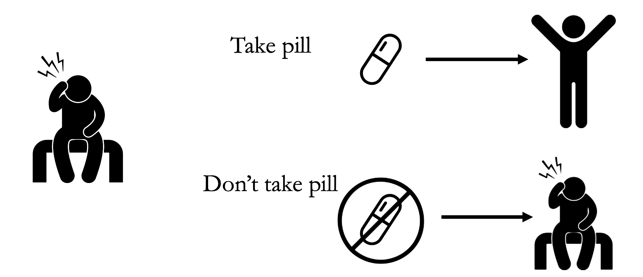
Potential Outcomes & Interventions

Slide 22


Slide 23
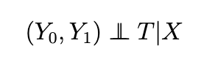
The Ignorability Assumption
In statistics, ignorability is a feature of an experiment design whereby the method of data collection (and the nature of missing data) does not depend on the missing data.
What this essentially means is that, all relevant features pertaining to a dataset are recorded within.
Mathematically, we can say that;

Slide 24
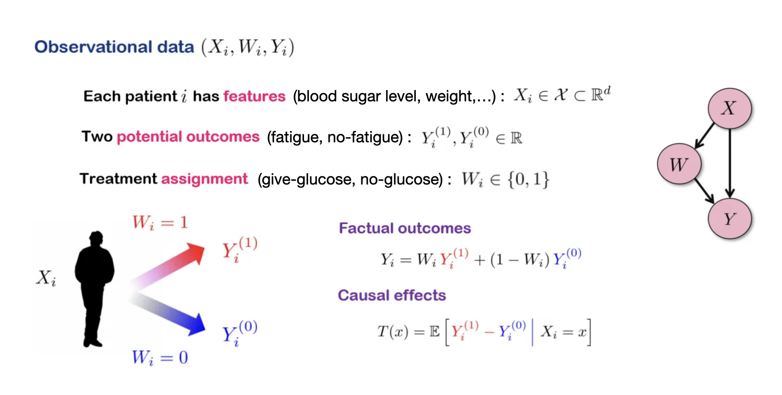
Curth, A. and van der Schaar, M., 2021, March. Nonparametric estimation of heterogeneous treatment effects: From theory to learning algorithms.

Slide 25
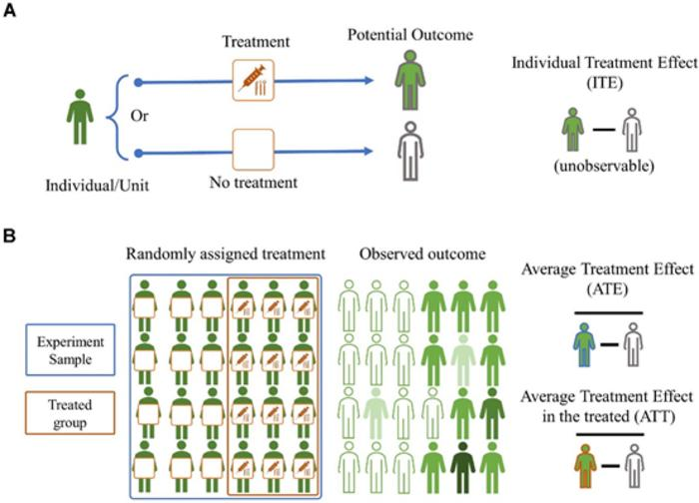

Slide 26
This framework is more famous amongst Machine Learning Scientists, while the former one is better appreciated by the Statisticians.
However, assuming ignorability in all use cases can be limiting. Hence, both frameworks come with a strong set of conditions.
The framework to be used can however be determined by the type of data and the inference / mining task to be performed.

Slide 27
Now that we have looked at the two main frameworks of causal inference, we can start looking at its applications.
Pertaining to these two schools of thought, there are two intuitive directions to proceed now;
Using Graphs for Causal Inference
Causality Informed Network Science

Slide 28
Graphs in Causal Discovery
Causal Relationships for different data are recorded in the form of Directed Acyclic Graphs (DAGs).
A contemporary area in Machine Learning Research is of learning such Causal Graphs from observational data, called ‘structure learning’.

Slide 29
In the simplest case, a Bayesian network is specified by an expert and is then used to perform inference.
In other applications, the task of defining the network is too complex for humans.
In many cases, the network structure and the parameters of the local distributions must be learned from data.

Slide 30
Causal structure learning represents an unsupervised learning process that can be broadly classified into:
Combinatorial Optimisation, where most algorithm search for a boolean valued or a discrete-valued adjacency matrix that captures the presence/absence of edges.
A more recent approach introduces the idea of continuous optimisation, that uses a real-valued adjacency matrix which can be tackled by optimizers with an acyclicity constraint.

Slide 31
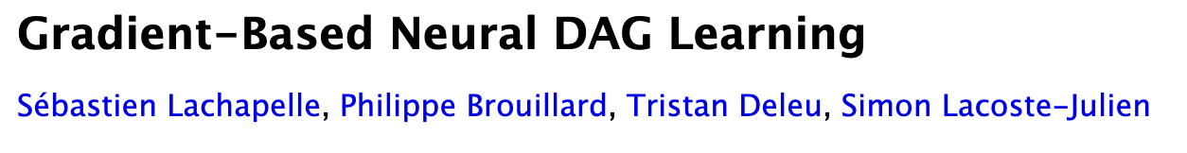
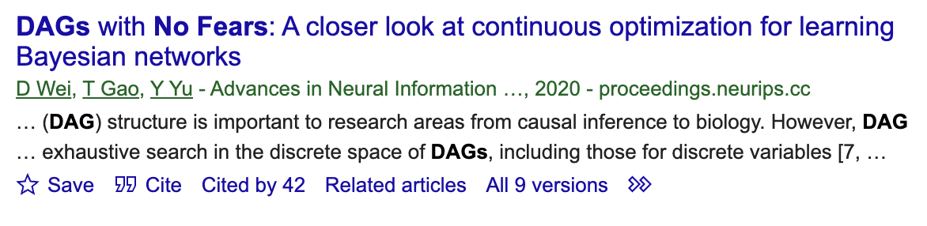
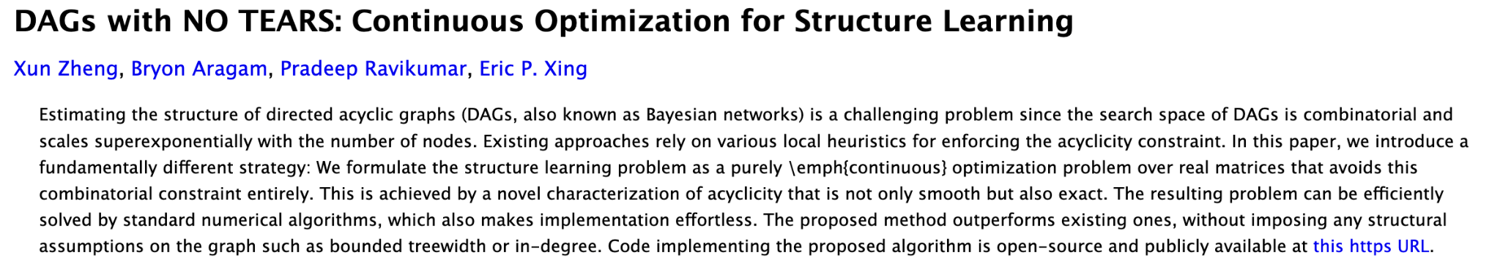
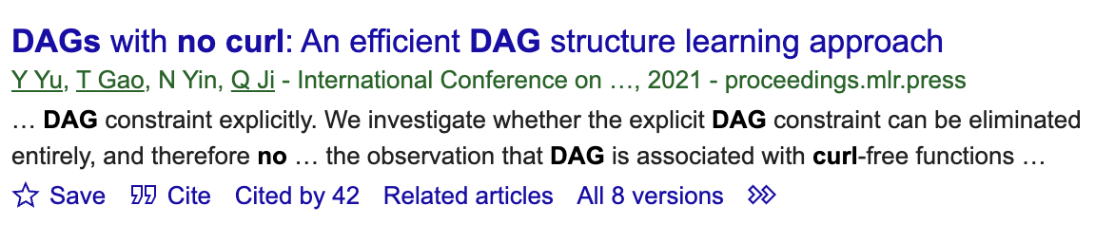
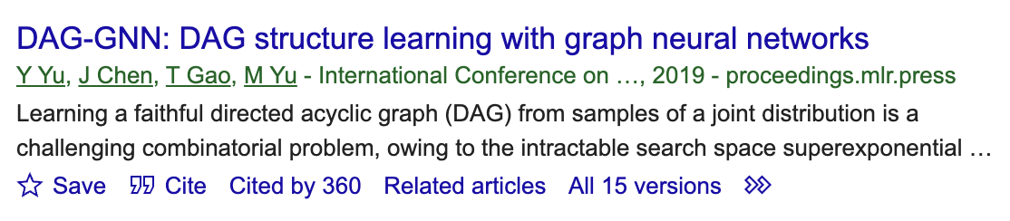

Slide 32
Types of Structure Learning
Constraint-Based: These algorithms perform a series of marginal and conditional independence tests, to identify undirected edges between variables and orientate some of those edges.
Score-Based: These algorithms rely on heuristic search techniques to explore the search space of possible graphs, and rely on objective functions to score each graph visited.
Hybrid: These approaches combine the above two aspects.

Slide 33
Causal Inference in Social Networks
Social Networks and Causal Inference, Tyler J. VanderWeele and Weihua An, 2013.

Slide 34
Experiments are a useful method to identify and estimate causal network effects.
For e.g., the effect of an intervention for one individual on outcomes of others, magnified or diffused by social ties.

Slide 35
The effects of interventions can be roughly divided into “network effects” and “effects on networks.”
Network effects concern how an intervention on one person may affect not only his or her own outcome but also the outcomes of others, and how the effect of the intervention may depend upon the structure of the network
Effects on networks concern how an intervention may alter the structure of the network itself.

Slide 36
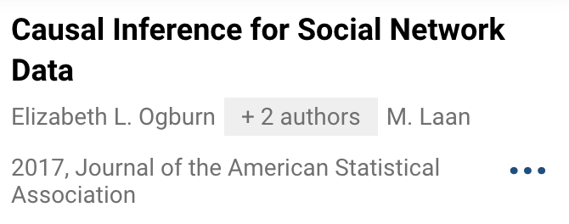
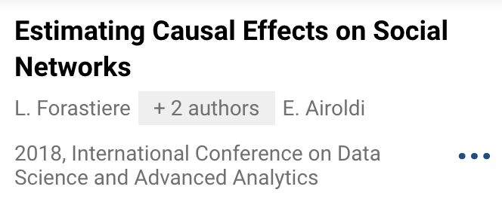
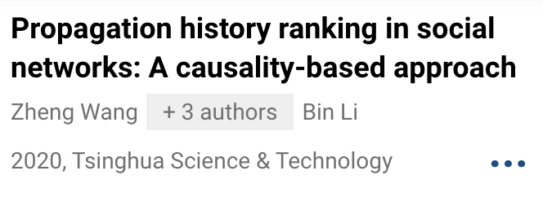
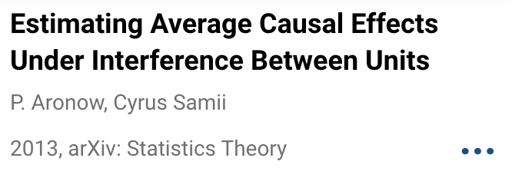
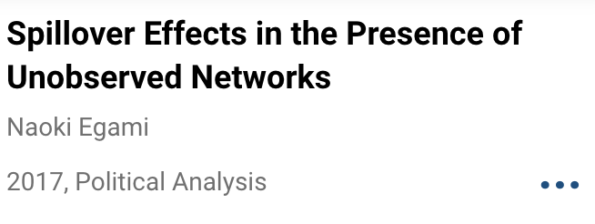
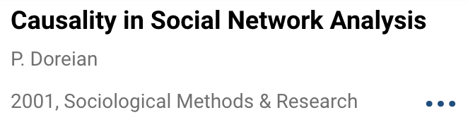
Notes:
In settings where some units are exposed to a treatment and its effects spills over connected units, estimating both the direct effect of the treatment and spillover effects presents several challenges. First, assumptions on the way and the extent to which spillover effects occur along the observed network are required. Second, in observational studies, where the treatment assignment is not under the control of the investigator, confounding and homophily are potential threats to the identification and estimation of causal effects on networks.
The author provides a broad characterization of social network analysis before considering the nature of causality. He distinguishes four types of causality: system causality, statistical causality, mechanism causality, and algorithmic causality. Their potential places in network analysis are discussed.
The framework integrates three components: (i) an experimental design that defines the probability distribution of treatment assignments, (ii) a mapping that relates experimental treatment assignments to exposures received by units in the experiment, and (iii) estimands that make use of the experiment to answer questions of substantive interest. Using this framework, we develop the case of estimating average unit-level causal effects from a randomized experiment
The Authors describe estimation and inference for causal effects that are specifically of interest in social network settings. We are not aware of any previous methods for inference about network members in observational settings that allow the number of ties per node to increase as the network grows.
The authors show that, unlike conventional omitted variable bias, bias due to unobserved networks remains even when treatment assignment is randomized and when unobserved networks and a network of interest are independently generated.
The goal is to rank participant edges/nodes by their contribution to the diffusion. The authors first discuss and adapt a causal measure, Difference of Causal Effects (DCE), as the ranking criterion. Then, to avoid the complex calculation of DCE, we propose two integrated ranking strategies by adopting two indicators. One is responsibility, which captures the necessity aspect of causal effects.

Slide 37
Conclusion
The notion of causal inference and discovery is slowly creeping up in Network Science.
The strength of causal reasoning for network effects seems to be seamless, and is still a relatively young field.
Causal reasoning isn’t always easy to integrate with real-world models, but does help in abstraction of the model itself!

Slide 38

Me: Thank you very much for your time! You:

